Slide 1
Workforce development, education and outreach
Panelists:
Albert Lazzarini LIGO, California Institute of Technology, Mohan Ramamurthy Unidata, University Corporation for Atmospheric Research,
Aaron Andersen National Center for Atmospheric Research
Ellen Rathje University of Texas at Austin Comments: http://goo.gl/oSi4ce
Moderators: Valerio Pascucci, University of Utah, Donald Petravick, NCSA/UIUC

Slide 2
Suggested questions to ignite discussion
What are workforce development related challenges and best practices, e.g., recruitment, training, incentives, reward structures, etc.?
How can we better facilitate awareness and sharing of solutions and best practices across different and disparate communities?
How can training and outreach become key mechanisms for concurrent improvement of workforce effectiveness and ability to adopt best tools and understand future needs?
How similar or different are the training needs of our community with respect to industry?
Can industry practices and resources be leveraged?
Is there a proper balance between technical and managerial training?
Does the funding model properly emphasizes workforce development?
Does the workforce training have a proper outlook towards a full career?
Comments: http://goo.gl/oSi4ce

Slide 4

Workforce development, and education and outreach
Albert Lazzarini Deputy Director, LIGO Laboratory California Institute of Technology
NSF Large Facilities Cyberinfrastructure Workshop Alexandria, VA 6-7 September 2017
1

Slide 5
1. What are workforce development related challenges and best practices, e.g., recruitment, training, incentives, reward structures, etc.?
LIGO is embedded in Division of Physics,Mathematics and Astronomy (PMA) at Caltech and MIT Kavli Institute for Astrophysics and Space Research
Able to recruit outstanding students, postdoctoral scholars for R&D, data analysis, detector (interferometer) commissioning & improvements
World-class mentoring available
Excellent record of placing outgoing individuals into next steps of their careers
Faculty, postdoctoral appointments, positions in industry
Scientific , engineering and professional staff world class
Scientists and engineers have a low turnover rate
Non-scientific staff has a greater turnover
University environment provides limited means to reward performance
Salary scales rigidly enforced across the campuses
Salary scales typically lag/lower industry
Fixed escalations can cover only COL increases
Moderate bonuses are used to recognize outstanding performance, initiative taking
Part of the rewardsystem includes conferences
Filling key senior positions from outside the Laboratory has proven beneficial in introducing ”new eyes,” different experiences, best practices
Broad searches for applicants
Can lead to disappointment for long-time staff

Slide 6
2. How can we better facilitate awareness and sharing of solutions and best practices across different and disparate communities?
LIGO IT leadership is engaged with other NSF supported efforts
Workflow & middleware implementation, utilization (Condor/Pegasus/OSG)
Identity management
Single-sign-on infrastructure
Code/pipeline optimization (XSEDE)
LIGO Laboratory established a Program Advisory Committee (PAC) over 20 years ago, near the end of initial construction
Appointment of directors from other NSF Large Facilities and DOE facilities has proven useful to “compare notes”
DOE laboratories have a tradition of Directors’ meetings without agency participation to discuss, identify common issues candidly
This has not been our experience at LIGO (except for the PAC)
LIGO Directorate has discussed approaching peers at other NSF facilities to explore whether there is interest in establishing a venue similar to the DOE laboratories’ for discussion
DOE laboratories tend to have a more common set of missions than the spectrum of disciplines represented in NSF Large Facilities.

Slide 7
3. How can training and outreach become key mechanisms for concurrent improvement of workforce effectiveness and ability to adopt
best tools and understand future needs?
Peer review can provide a mechanism for improvements
Staff enabled to attend professional meetings
LIGO cybersecurity group has invited external peers to assist in internal audits, reviews – not done frequently enough
Safety: We have asked other (NSF, DOE) facility safety officers and consultants to participate in bi-annual safety inspections of the LIGO observatories
Received helpful advice, learned about best practices, reinforcement of our own protocols
External peer review of the LIGO Property Life-cycle Management Plan (PLMP)
Reviewers drawn from other (DOE, ESO, Smithsonian) facilities
Provided useful feedback on our plan

Slide 8
How similar or different are the training needs of our community with respect to industry? Can industry practices and resources be
leveraged?
IT/scientific/engineering staff encouraged to attend professional development & training workshops, etc.
Provides ability to interact with peers in industry
Business practices can benefit– training of our administrative, business personal has proven beneficial

Slide 10
Workforce development, and education and outreach
Panel Discussion September 6, 2017
Mohan Ramamurthy Unidata Program Center
University Corporation for Atmospheric Research
Boulder, CO 80301 USA

Slide 11
Unidata: Began as a University Data Project
Established in 1984; Primarily funded by NSF
Acquire and distribute real-time meteorological data;
Develop software for accessing, managing, analyzing, visualizing geoscience data;
Provide training and support to users;
Negotiate data & software agreements on behalf of universities;
Facilitate advancement of standards and conventions and implementation of data management plans;
Provide equipment grants to further education and research through participation in Unidata;

Slide 12
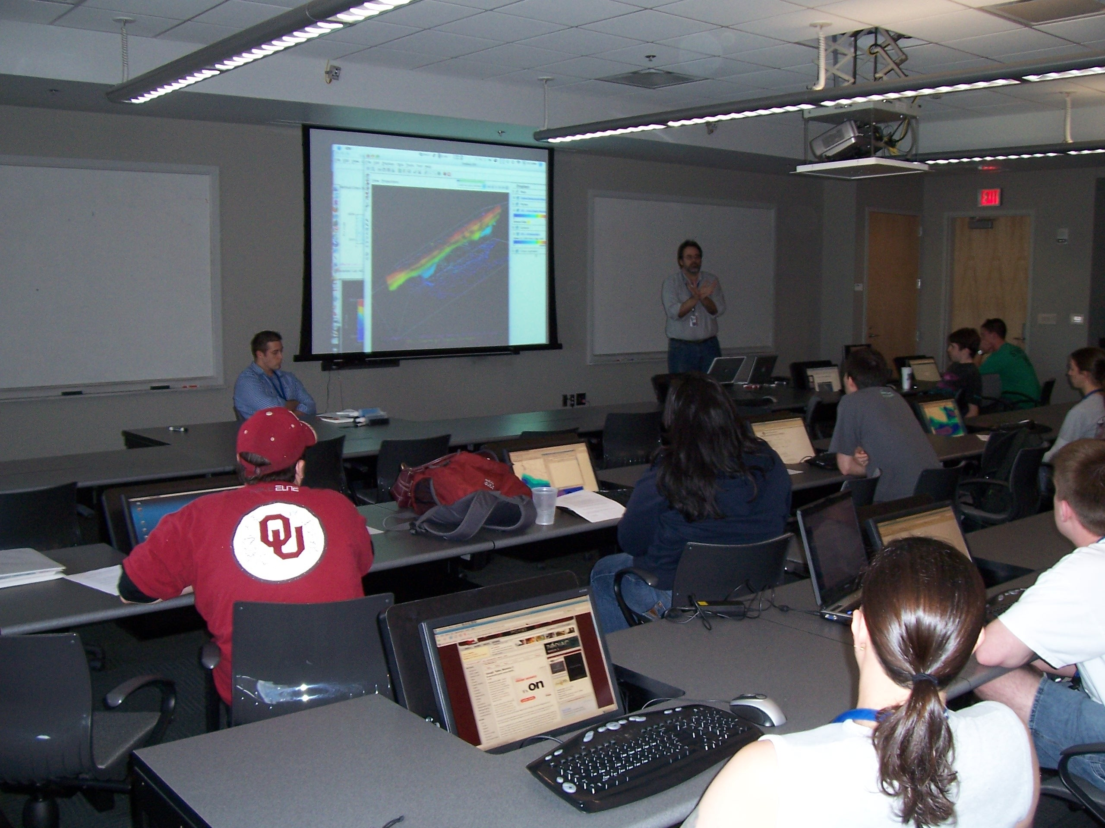
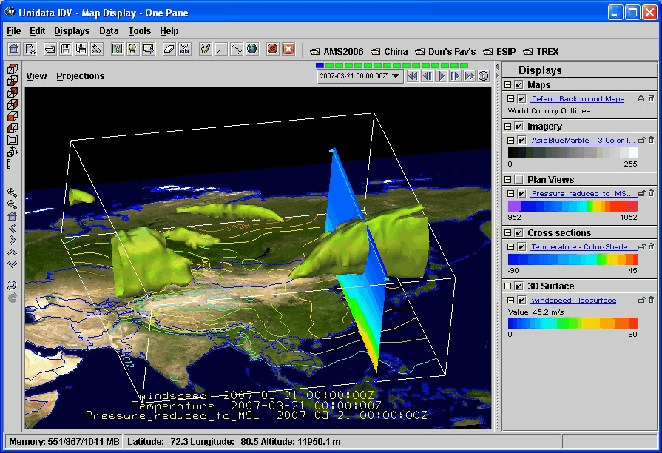
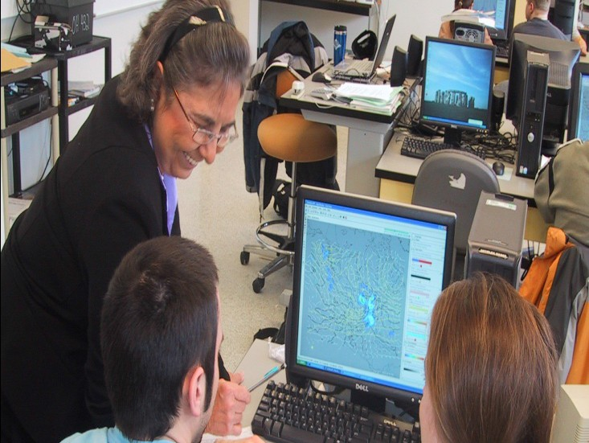

Key Metrics
About 50,000 registered users
~1500 academic institutions
~7000 organizations in all sectors in nearly all countries
Yearly software downloads: ~150,000
Amount of data “pushed” to users in a year:
3.4 petabytes; data “pulled”: ~400 Terabytes/year
Over 50% of the M. S. and Ph. D. students in Atmospheric Science programs in the U. S. use data and software from Unidata. In some programs, the use is over 90%.
> 100,000 students are exposed each year to products generated using Unidata data systems and software.

Slide 13
A Snapshot of Products & Services
Software:
Data Distribution: LDM
Remote Data Access: THREDDS Data Server, ADDE, and RAMADDA
Data Management: netCDF, UDUNITS, and Rosetta
Analysis and Visualization: GEMPAK, McIDAS, IDV, and AWIPS II
GIS support via TDS (WCS, WMS) and KML and Shapefiles
Community Engagement; Equipment Awards to universities; Seminars; Advocacy;
Data:
Over 30 data streams provided in real-time
Data collection, cataloging, and distribution
Both push and pull technologies are used
User Support & Training: Direct email support Community mailing lists (~60)
Annual Training Workshops, Triennial Users Workshops, and Regional Workshops, and internership programs.
Community:

Slide 14
What are workforce development related challenges and best practices, e.g., recruitment, training, incentives, reward structures, etc.?
Salaries in the sciences have not kept up with those in the IT domain.
Universities need to provide both education and training on Contemporary Software Engineering Practices
E.g., Software Carpentry, Data Carpentry,
Leverage Pyton/Jupyter Notebooks, Docker, Cloud Computing
Data Science has emerged as a new discipline, alongside of library, information, and computer/computational science
New technologies are becoming available to students: VR/AR and immersive learning experiences.

Slide 15

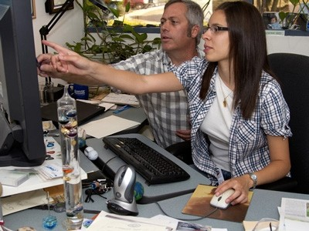
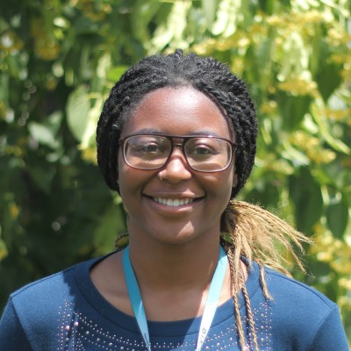
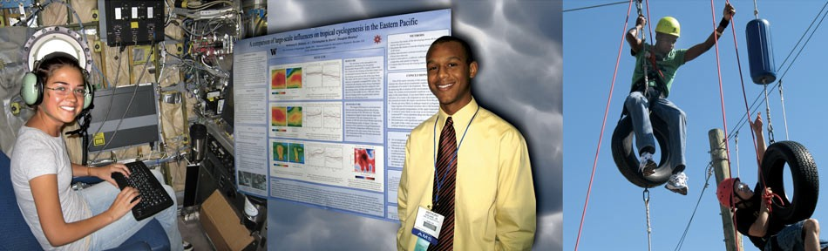
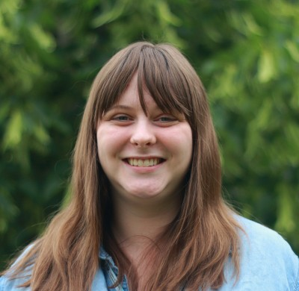
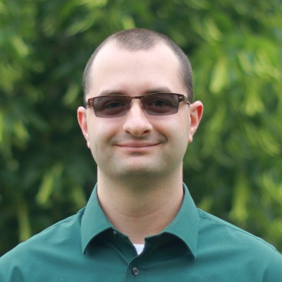
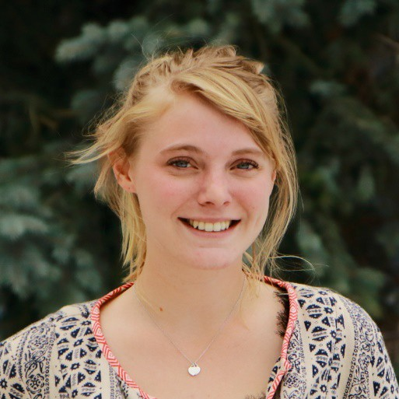
Workforce Development: Best Practices
SOARS, SIParCS, REU, and other Internship Programs

Slide 16
How can we better facilitate awareness and sharing of solutions and best practices across different and disparate communities?
Facilities have a unique role in addressing above: Data, software, and services
Hands on data integrated or data-centric science education is extremely important;
Geosciences have particular relevance with real- world problems, tools, etc. – Mention Harvey, Sandy, Katrina, Tsunami, Earthquakes, Volcanic eruptions
The EarthCube initiative has established a Council of Data Facilities – a group of GEO data facilities that have shared interests

Slide 17
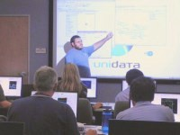
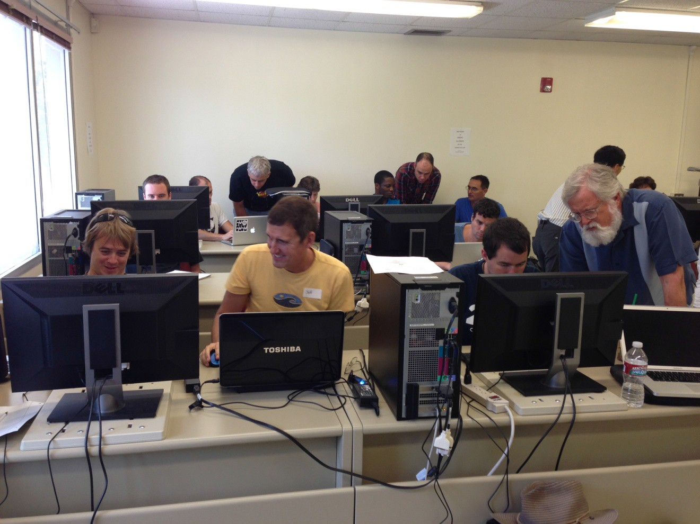
How can training and outreach become key mechanisms for concurrent improvement of workforce effectiveness and ability to adopt best tools and understand future needs
Unidata offers training workshops on its software and data systems.
The workshops are developed and presented by the software developers.
Unidata also conducts regional workshops at universities on topics of interest those universities.

Slide 18
How similar or different are the training needs of our community with respect to industry?
Can industry practices and resources be leveraged?
Industry has developed many of the emerging and novel solutions for dealing with big data analytics and machine learning (e.g., Hadoop, Spark, Cloud and Container technologies like, Block Chain, etc.)
Data Science has emerged as a new field in academia
Many of the above tools and technologies are now being leveraged by academia
Many opportunities for training and professional development has emerged for students and researchers.

Slide 20
Workforce development, education & outreach
Aaron Andersen
Director Operations & Services
NSF Large Facilities Cyberinfrastructure Workshop
6-7 September 2017

Slide 21
What are workforce development related challenges and best practices, e.g., recruitment, training, incentives, reward structures, etc.?
Location is one of our best recruiting tools
However location also works against us
Cost of living 19.5% above national average
Unemployment hit 1.8% in May 2017
Retention is bimodal
Not many challenges in science and engineering positions
Information technology has been challenging for some time
Diversity is a challenge

Slide 22


Worked diligently on developing a pipeline
SOARS - Significant Opportunities in Atmospheric Research and Science
https://www.soars.ucar.edu/
SiParCS - Summer Internships in Parallel Computational Science
https://www2.cisl.ucar.edu/siparcs

Slide 23
How can we better facilitate awareness and sharing of solutions and best practices across different and disparate communities?
Partnerships, Partnerships, Partnerships
Rocky Mountain Advanced Computing Consortium
19 Members
Women in Networking at SC
Keystone Initiative for Network Based Education and Research (KINBER), NCAR, ESnet, Supercomputing Conference (SC), NSF
University of Wyoming
Rasberry Pi – Teaching Teachers
Wyoming Workforce Development Council
NCAR Staff appointed by Wyoming Governor
Trades in Technology

Slide 24
How can training and outreach become key mechanisms for concurrent improvement of workforce effectiveness and ability to adopt best tools and understand future needs
SOARS and SIParCS Programs based on a mentoring model
As a mentor it is not unusual to be stretched and learn along with the mentee
Because of funding constraints has become a way to tackle higher risk or more innovative approaches with student internships first

Slide 25
How similar or different are the training needs of our community with respect to industry? Can industry practices and resources be leveraged?
In many regards Yes
Diversity, Cybersecurity, Specific Technologies
Good success with conferences, webinars, local communities of practice in software engineering
In some regards No
Internship programs demonstrate a few key areas
Research methodologies, presentations, abstract preparation, technical writing, poster sessions and venues to practice

Slide 27

A Cyberinfrastructure for the Natural Hazards Community
Prof. Ellen M. Rathje
Warren S. Bellows Centennial Professor
Dept. of Civil, Arch., and Env. Engineering
University of Texas at Austin

Slide 28
NHERI: Natural Hazards Engineering Research Infrastructure
NSF-funded, shared-use research infrastructure for research in natural hazards engineering
Network Coordinating Office (NCO)
Cyberinfrastructure (CI)
Seven experimental facilities (EF)
Post-disaster, rapid response research facility (RAPID)
Computational Modeling and Simulation Center (SimCenter)
Replaces similar program for earthquake engineering (NEES) but expanded to include windstorms and associated hazards

Slide 29



NHERI Facilities Supported by CI
NCO
EF
RAPID
EF
EF
CI
EF
SimCenter
EF
EF
EF
From Dan Wilson, UCD

Slide 30
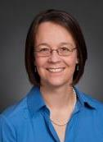
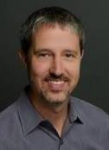
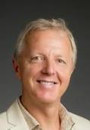
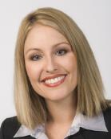
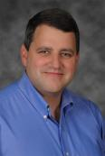

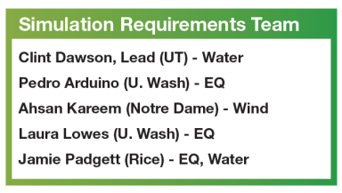
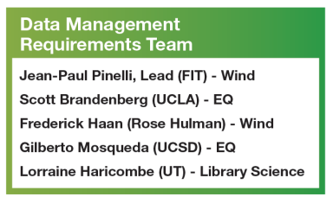
DesignSafe-ci Organization
Director
Ellen Rathje
Univ. of Texas
Simulation
Clint Dawson
Univ. of Texas
Data
Jean-Paul Pinelli
Florida Inst. Tech.
ECO
Jamie Padgett
Rice Univ.
CI
Dan Stanzione
Univ. of Texas

Slide 31
Workforce development related challenges & best practices
Biggest challenge is competing on a salary basis with the local tech companies like Apple, Intel, Oracle, Google, IBM, as well as start ups
Career paths provided by academic positions
Younger developers often looking for monetary rewards, most stay in positions 2-3 yrs
“Older” developers may be motivated by stability of an academic position
Need a better raise/reward structure than X%/year
Staff are rewarded by the academic atmosphere and the amazing science that we enable

Slide 32
Workforce development related challenges & best practices
The competition for software developers is fierce
Issues with H1B Visa → Green Card
Recruit at SXSW Interactive and at the annual Supercomputing Conference (SC)
Initiating a “Professional Intern Program” to evaluate entry-level talent
3-5 in a cohort with 120 day contracts
Each receive a real wage and valuable experience
We get to choose the most productive for potential full time offers

Slide 33
Workforce development related challenges & best practices
Training is supported by sending developers to conferences such as DockerCon and DjangoCon
Teaching is a great way for staff to have to keep current with the latest tech trends.
Training for our users throughout the year
Teaching for-credit courses at UT
Summer institute series of week-long immersive trainings
Need management professionals with formal management training
TACC-NAG Short Course: HPC Concepts for Managers
September 12-14, 2017

Slide 34
Facilitating awareness and sharing best practices across LF?
More continuous communication/interactions between facilities.
Meeting annually for the Large Facilities Workshop is important, but we all return to our respective institutions and rarely engage each other except for the annual meeting
Could organize monthly or quarterly communication
All of us perform training and outreach, so it would valuable if there was a central communication method for Large Facilities to announce/post training events.

Slide 35
How can training/outreach improve of workforce effectiveness, etc.
The interaction that occurs between our staff and our users through our training activities keeps us current with their needs so that we do provide the appropriate tools and keep a pulse on future trends.
These events are sources of ongoing requirements gathering, and it is important to communicate and document such requirements.

Slide 36
Similarity of the training needs of our community compared with industry?
The CI training needs are similar for system administrators, cybersecurity engineers, network engineers, software developers, etc.
The main difference is that industry will have individual staff dedicated to each of those jobs, where in academia we often have individual staff members with expertise spanning multiple of those areas.
While we have staff who attend some of the same conferences/training that industry attends, we also have industry coming to us for training

